Slide 1
The Dollar-for-Dollar Leverage Account
Getting the most from your investment through the power of arbitrage
For Financial Professional Use Only

Slide 2
If
“A Dollar Saved Is A Dollar Earned”
Then is it safe to say……
“A Dollar Spent Is A Dollar Gone?”
For Financial Professional Use Only

Slide 3
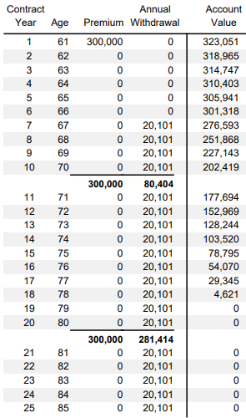
WITHDRAWALS
Annuity
401k
IRA
403b
Market Account
Bank
Nothing left working in the market!
EVERY DOLLAR SPENT IS A DOLLAR GONE
For Financial Professional Use Only

Slide 4
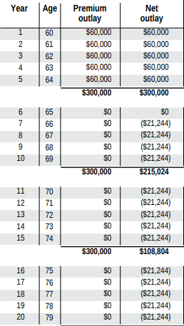
LOANS
Life Insurance
Loan
Loan is from carrier’s general account
Death benefit is collateral
Loan paid back using death benefit at time of death
NEVER LOSE YOUR EARNING POWER!
For Financial Professional Use Only

Slide 5
THE POWER OF ARBITRAGE
(The Math)
Policy: $200k Accumulation Value
Loans: $100k
1st 100k earning 7%
2nd 100k earning 7%
Encumbered by a 4% Loan
Earning 7%
- Paying 4%
= 3% Gains
On Money You’ve Already Spent!
LIFE INSURANCE ARBITRAGE IS THE SPREAD BETWEEN YOUR INDEX CREDITING RATE AND YOUR LOAN INTREST RATE
For Financial Professional Use Only

Slide 6
Current Cap & Loan Rate

Slide 7
8% Cap &
5% Loan Rate

Slide 8
A Dollar Spent Is No Longer A Dollar Gone!
Through the power of arbitrage, every dollar you spend remains in your indexed account, receiving a full rate of return!
Never lose leverage on your money!
For Financial Professional Use Only

Slide 9
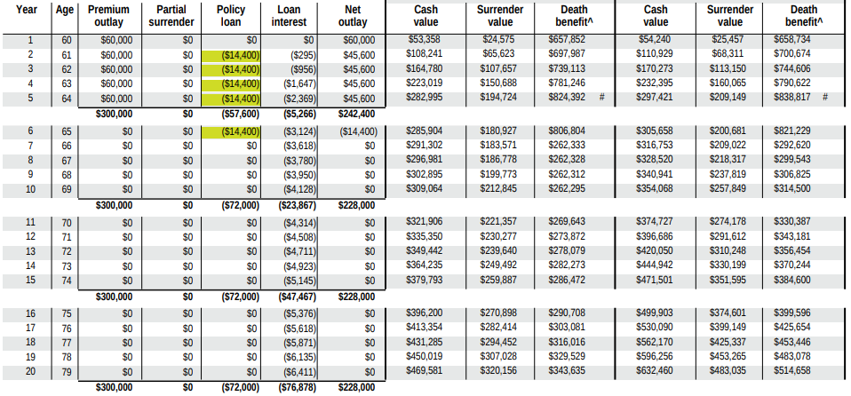
Application
ROTH Conversion Alternative
Loans to pay taxes on transfer (leverage on tax dollars)
Premiums funded from qualified account
For Financial Professional Use Only

Slide 10
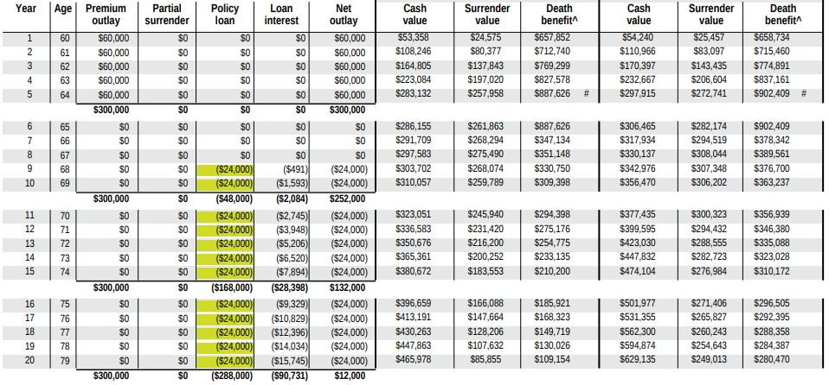
Application
Tax Fund Account
Loans to pay income taxes in retirement (based on 100k annual earned income at a 24% tax rate)
Premiums funded with after tax dollars
For Financial Professional Use Only

Slide 11
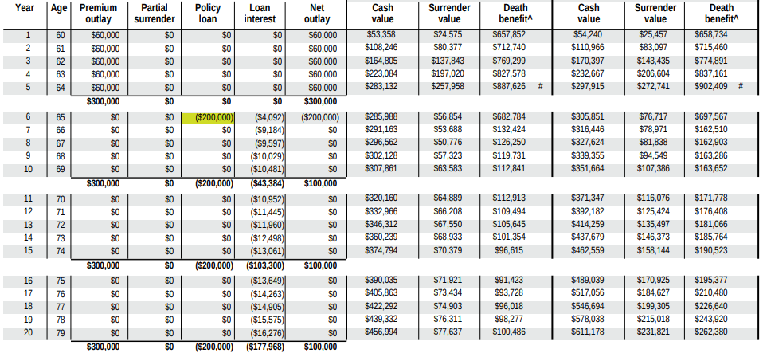
Application
Debt Repayment
Loans to pay off outstanding debt prior to retirement (eliminating debt interest while leveraging payment dollars)
Premiums funded with after tax dollars
For Financial Professional Use Only

Slide 12
Other Applications…..
Long Term Care Premiums
College Funding
Family Gifts
Funding Additional Policies
Endless Possibilities!
Where do you want the most leverage?
For Financial Professional Use Only

Slide 13
What Can You Do With A Tax-Free Bucket of Money?
Anything you want to!
And keep your interest earning power while you do it!
For Financial Professional Use Only

